Slide 1

Dominate Your Enterprise and Your Software Delivery Using XebiaLabs and AWS
Jay Yeras, AWS
Tim Buntel, XebiaLabs

Slide 2
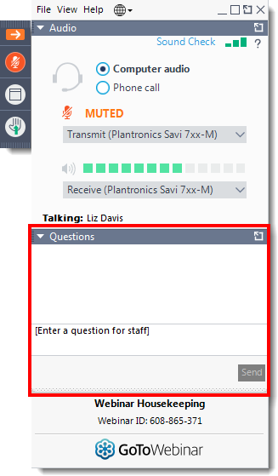
Housekeeping
This webinar is being recorded
Links to the slides and the recording will be made available after the presentation
You can post questions via the GoToWebinar Control Panel

Slide 3


Meet Your Presenters
Jay Yeras
Tim Buntel
Partner Solutions Architect
AWS
DevOps Advocate
XebiaLabs

Slide 4

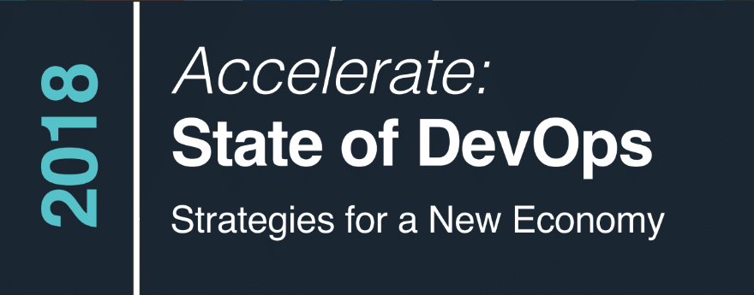

http://devops-research.com
© 2018, DevOps Research and Assessment, LLC. All Rights Reserved.
http://devops-research.com

Slide 5
Elite Performers Are More Agile
46x
2,555x
more frequent deployments
faster lead times from commit to deploy
Source: DORA: Accelerate: State of DevOps 2018: Strategies for a New Economy: https://devops-research.com/2018/08/announcing-accelerate-state-of-devops-2018/

Slide 6
Elite Performers Are More Reliable
7x
2,604x
lower change failure rate
(changes are 1/7 as likely to fail)
time to recover from incidents
Source: DORA: Accelerate: State of DevOps 2018: Strategies for a New Economy: https://devops-research.com/2018/08/announcing-accelerate-state-of-devops-2018/

Slide 7
Elite Performers Do Cool Stuff
25%
20%
Less time spent on manual work
More time spent on new work
Source: DORA: Accelerate: State of DevOps 2018: Strategies for a New Economy: https://devops-research.com/2018/08/announcing-accelerate-state-of-devops-2018/

Slide 8
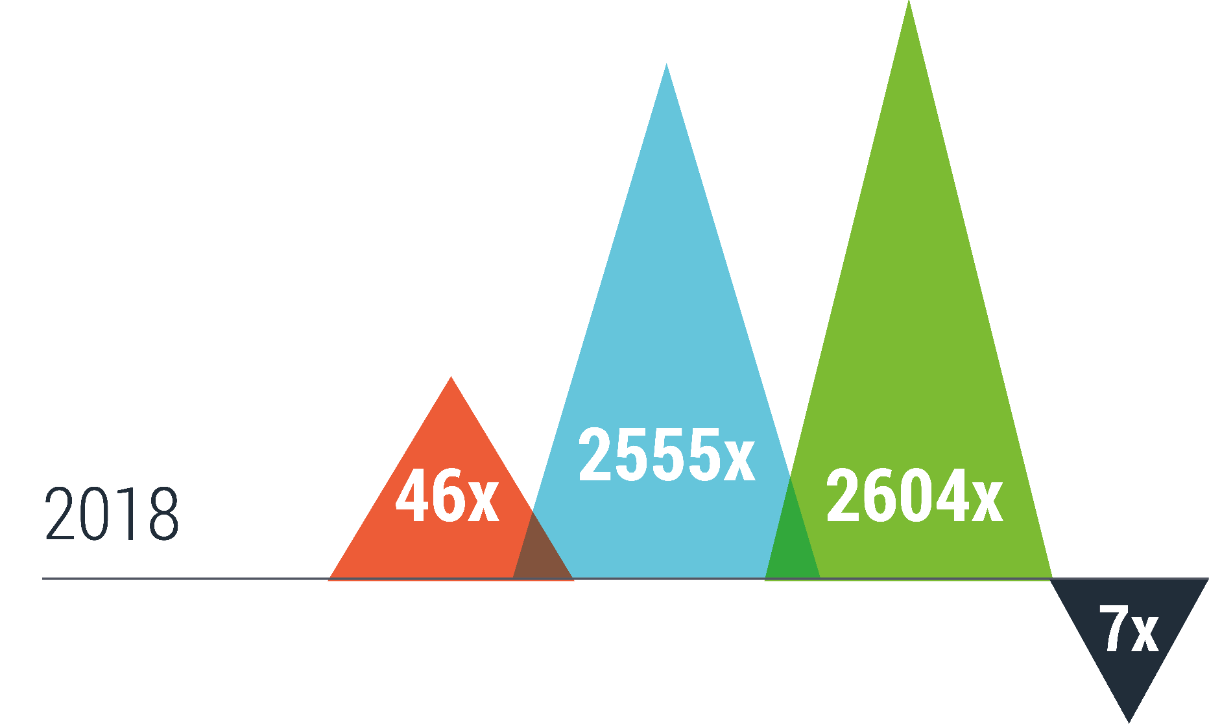
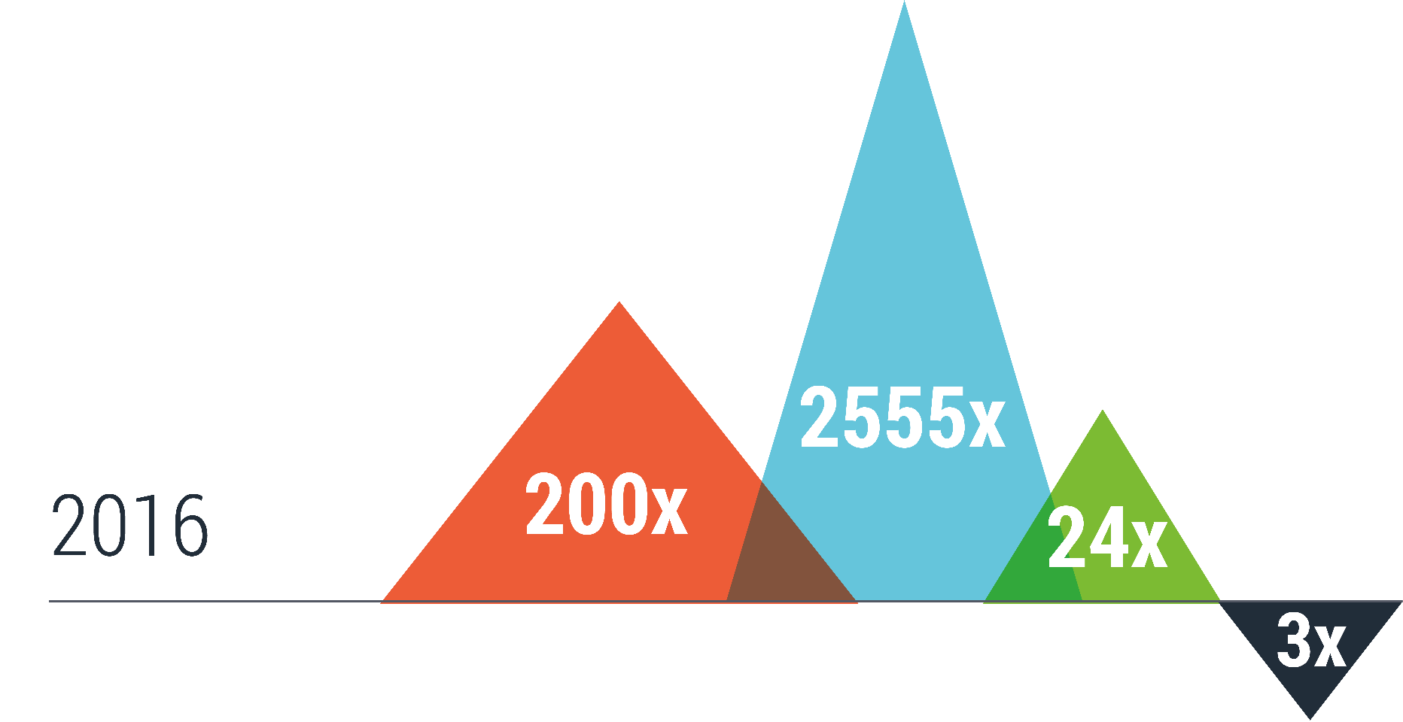
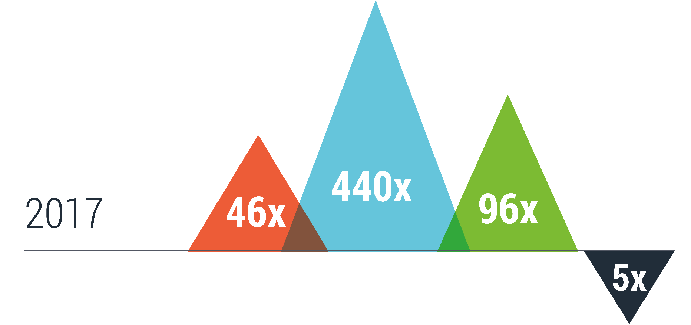
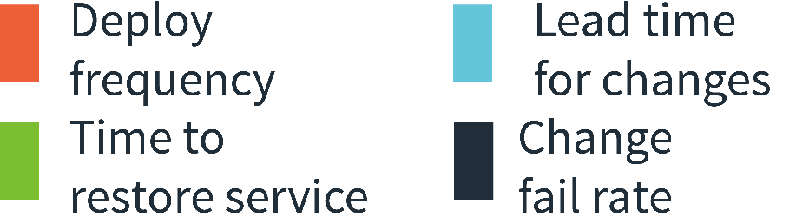
Better and Better
Source: DORA: Accelerate: State of DevOps 2018: Strategies for a New Economy: https://devops-research.com/2018/08/announcing-accelerate-state-of-devops-2018/

Slide 9
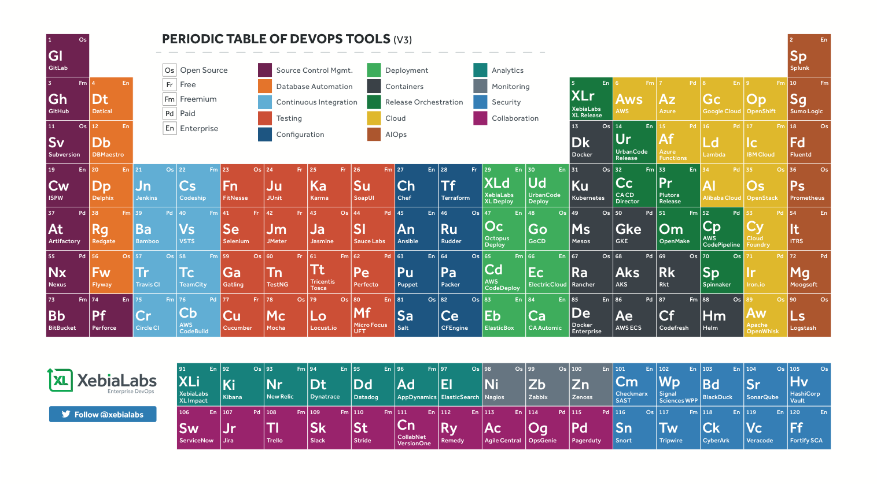
So Many Tools!

Slide 10
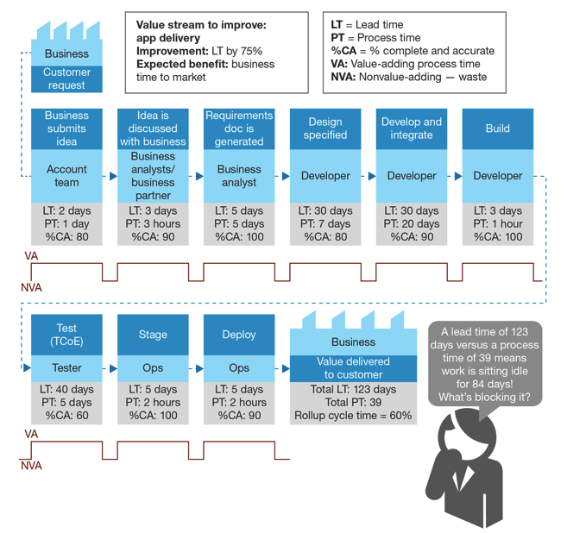
Scaling Challenges
Wait time Typically > Task Time
Compliance
Visibility
Maintainability
Repeatability
Technical and Non-technical Participants

Slide 11


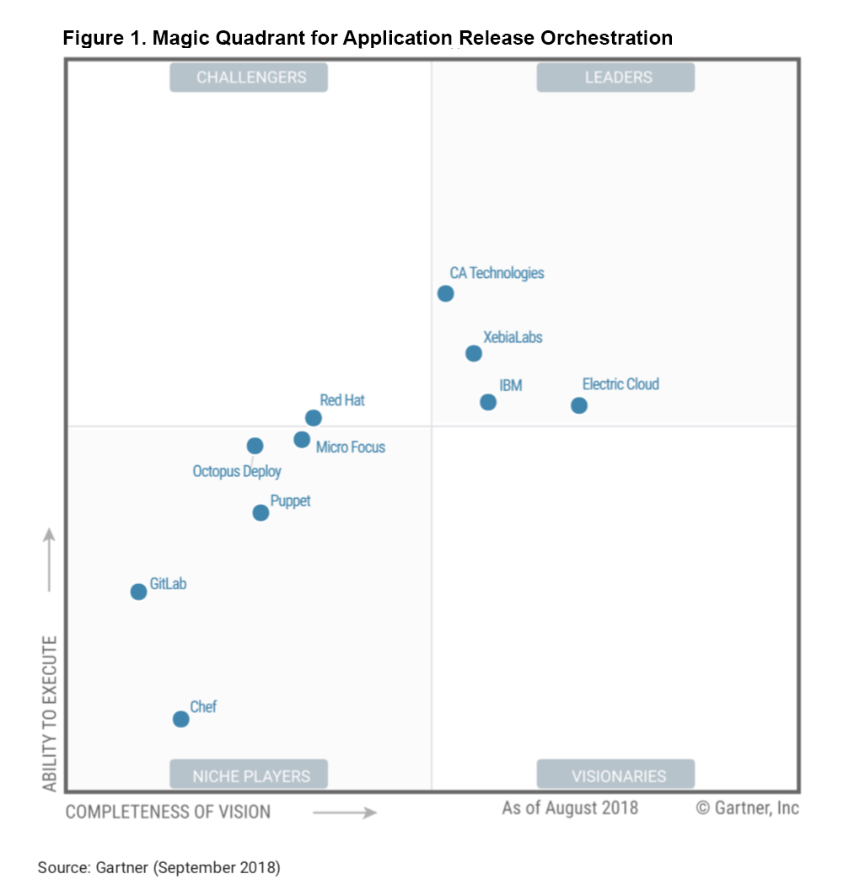

Enterprise DevOps Platform providing intelligence, automation and control across the entire software delivery process
Hundreds of Companies deliver software with XebiaLabs - faster, safer and more customer focused
Top-ranked
Continuous Delivery and DevOps pioneer, authority and technology leader
Global team in the US, Europe & APAC
Notes:
Derek

Slide 12
The DevOps Platform for the Enterprise
dev
test
uat
prod
EC2
S3
ECS
Lambda
Fargate

Slide 13


AWS Support In Platform 8.2
XL Deploy AWS plugin
Enables XL Deploy to work with AWS Services such as:
Elastic Compute Cloud (EC2)
Simple Storage Service (S3)
EC2 Container Service (ECS)
AWS Lambda functions and AWS API Gateway
Fargate
XL Deploy Tasks
Enables XL Release to orchestrate, automate and view software delivery pipelines that include AWS tasks such as:
Launch / terminate AWS EC2 and VPC instances
Deploy application to AWS cloud-based instances
Provision EC2 instances & deploy applications to them
Deploy AWS Lambda functions
Provision AWS API Gateway to invoke Lambda functions
Fargate deployments
Release
Deploy
AWS

Slide 14




Workflow
Amazon ECR
Git Clone
Docker Pull
Docker Push
AWS CLI
Create Stack
AWS CloudFormation

Slide 15
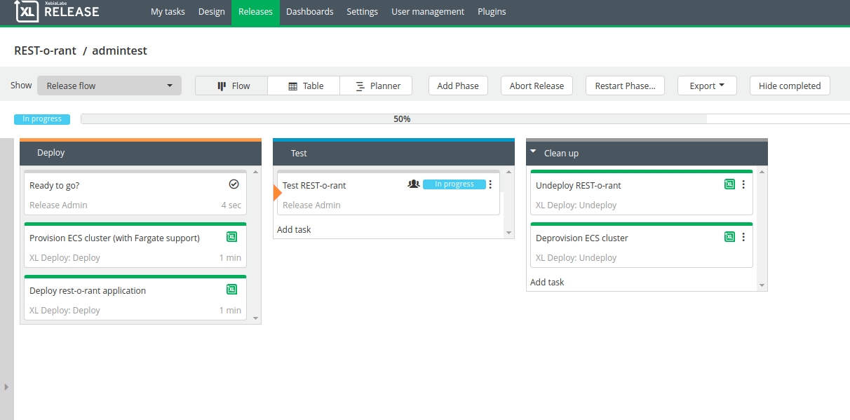

Slide 16
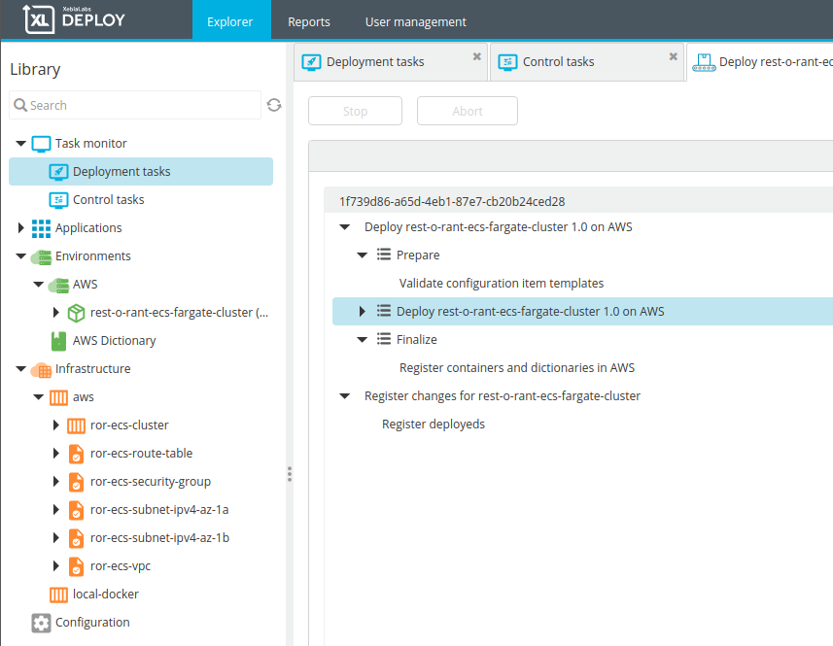

Slide 17

Questions?
Xebialabs.com/community/events/hop-on-the-xebialabs-bus/
Sep-25 | Dallas, TX
Sep-25 | Seattle, WA
Oct-2 | Chicago, IL
Oct-16 | Jersey City, NJ
Oct-17 | Atlanta, GA
Oct-30 | Washington, D.C.

Slide 18
Thank You!
Resources
http://www.xebialabs.com/
https://aws.amazon.com/
https://github.com/xebialabs/AWSWebinar

